Slide 1
Stats Projects and Defs Review

Slide 2
A/B test
An A/B test takes two randomized groups, A and B, and provides them with different experiences.
In the A/B test, we measure the response of each group to understand the impact each experience had on the response.

Slide 3
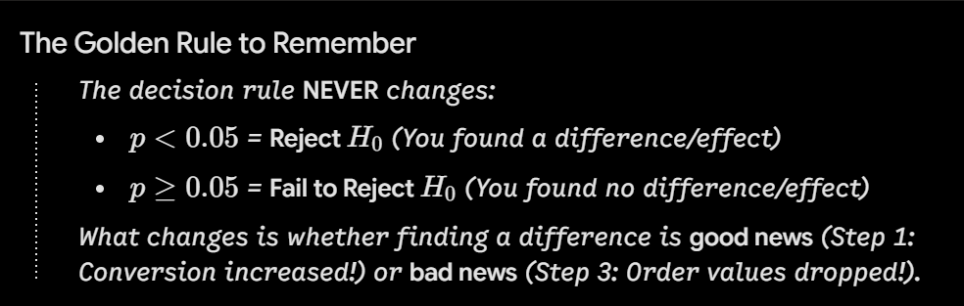
Hypothesis Test
A Hypothesis Test is a statistical method used to evaluate the likelihood of an assumption on a population using sample data. It determines whether an observed pattern or correlation in the data is due to a true relationship or due to random chance.
“Null Hypothesis”: is a statistical assumption stating that there is no statistically significant relationship, association, or difference between two outcomes or groups.
The Alternate Hypothesis is that there is a true relationship
The significance level is a specified p-value threshold in which we are measuring our null hypothesis against.

Slide 4

Project 1
Assessing Campaign Performance
Using Chi-Square Test OF Independence

Slide 5
Task
In June, a grocery retailer client ran a campaign to promote their new “Delivery Club” memberships. Signing up for the club costs $100 and gives customers free grocery deliveries for one year, starting July 1st.
For the campaign promoting the club, customers were put randomly into three groups:
The first group received a bland, low cost mailer, Mailer 1.
The second group received a colorful, high quality, high cost mailer, Mailer 2.
The third group was a control group. They did not receive any mail.
The client knows that customers who were contacted, signed up for the Delivery Club at a far higher rate than the control group, but are now curious as to if there is a significant difference in customer signup rate between the cheap mailer and the expensive mailer. This will allow them to make more informed decisions in the future, such as whether it is worth it to spend the money on higher cost mailers or not.

Slide 6
Actions
The Chi-Square Test of Independence will be applied to compare the signup rates of two distinct groups from our campaign_data client database:
Set up A/B test: Set null hypothesis, alternate hypothesis, and the significance level (0.05)
Aggregate the observed data of mailer_type and signup_flag into a 2x2 contingincy matrix. We’ll then feed these observed frequencies to the chi2_contingency algorithm provided by the scipy library to calculate the expected values, p-values, Degrees of Freedom (dof), and the Chi-Square Statistic.
Compare output p-value to significance level
Use chi2ppf to obtain the Critical Value
Compare output Chi-Square Statistic to the calculated Critical Value

Slide 7
Discussion
Goal: Find out if the mailer quality truly influenced whether a customer signed up or not for the promotion
Results:
Chi-Square Statistic: 1.72 < Critical Value: 3.84
p-value: 0.19 > Acceptance Criteria 0.05
Conclusion: The Chi-Square Test of Independence indicated that there was no statistically significant difference in how many people signed up from the tested mailer groups. We fail to reject the Null Hypothesis.
Business Recommendations: Do not yet commit to the fancier mailer. There is not conclusive evidence that the mailer had an impact on signup rates. More testing should be done when promoting the next campaign.

Slide 8
Chi-Square Decision Rule
Chi-Square Test of Independence: A Hypothesis Test where the observed frequencies from data points in a sample are compared against the expected frequencies to see if the two variables were truly independent
The Chi-Square Contingency function provides a Chi-Square Statistic that can be compared against a calculated critical value, in order to reject or fail to reject a null hypothesis.
  Chi-Square Statistic < Critical Value: We retain the null hypothesis - the observed results could easily happen under random variation, meaning there isn’t enough evidence to prove a true association exists between variables
  Chi-Square Statistic ≥ Critical Value: We reject the null hypothesis - the observed results are highly unlikely to have occurred by chance providing strong evidence that an association exists between variables

Slide 9
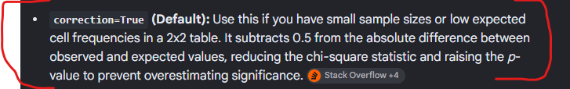
Chi-Square Methods
from scipy.stats import chi2_contingency, chi2
Use crosstab().value method to get an array of expected observed frequencies
chi2_statistic, p_value, dof, expected_values = chi2_contingency(observed_values, correction = False)
# correction = Yate's correction, if dof is == 1 [2 x 2] matrix, correction must be True
critical_value = chi2.ppf(1 - acceptance_criteria, dof) # percentage point function

Slide 10

Project 2
Customer Checkout UI Redesign A/B Test

Slide 11
Task
An e-commerce retailer redesigned their customer checkout user interface (UI) in an effort to streamline the cart-to-purchase process and improve checkout conversion rates.
The campaign was run across a 30-day testing window where incoming site traffic was randomly split between two groups:
- The `Control Group` used the legacy UI to complete purchases
- The `Test Group` used the new redesigned UI to complete purchases
The product and marketing teams logged daily performance metrics including number of items added to carts, number of completed purchases, and the total spent by customers on a day-to-day basis.
**<u>Objective:</u>** Determine if the redesigned UI significantly improves cart-to-purchase conversion rates without negatively impacting Average Order Value (AOV).

Slide 12
Actions
1. **Primary Metric Evaluation (Conversion Rate):**
* <u>Objective:</u> Determine whether the new checkout UI drives a statistically significant lift in cart-to-purchase conversion rates.
* <u>Method:</u> Run a Two-Sample Z-Test for Proportions with `statsmodels`.
2. Normality Diagnostic (Daily Average Order Value):
* <u>Objective:</u> Evaluate whether daily Average Order Value (spent/purchased) meets the parametric assumption of a normal distribution.
* <u>Method:</u> Run a Shapiro-Wilk Test on daily AOV for both Control and Test groups using `scipy.stats`.
3. Secondary Metric Evaluation (AOV Impact)
* <u>Objective:</u> Assess whether customer spending per completed order changed significantly between UI variants.
* <u>Method:</u> Select the final two-sample test based on the Shapiro-Wilk diagnostic. If the data is normally distributed, run the Welch's *t*-Test. If the AOV data is non-parametric, run the Mann-Whitney U Test with. Use `scipy.stats`.

Slide 13
Discussion
  Goal: Conducted the Z-Test for Proportions to test on 2 versions of an ecommerce websites’ checkout User Interface to determine if there is a statistically significant difference in items purchased… Assessed data for normality with the Shapiro-Wilk, leading to the commencement of non-parametric test, Mann Whitney U test. Relative lift was ___ and business decision ____
2
Goal: How? Conclusions? Business recs?

Slide 14
Definitions
  Goal: Conducted the Z-Test for Proportions to test on 2 versions of an ecommerce websites’ checkout User Interface to determine if there is a statistically significant difference in items purchased… Assessed data for normality with the Shapiro-Wilk, leading to the commencement of non-parametric test, Mann Whitney U test. Relative lift was ___ and business decision ____
2
Goal: How? Conclusions? Business recs?

Slide 15
Project 3

Slide 16
Causal Impact Analysis
  CRAIG: Conducted the Z-Test for Proportions to test on 2 versions of an ecommerce websites’ checkout User Interface to determine if there is a statistically significant difference in items purchased… Assessed data for normality with the Shapiro-Wilk, leading to the commencement of non-parametric test, Mann Whitney U test. Relative lift was ___ and business decision ____
2
Goal: How? Conclusions? Business recs?

Slide 17
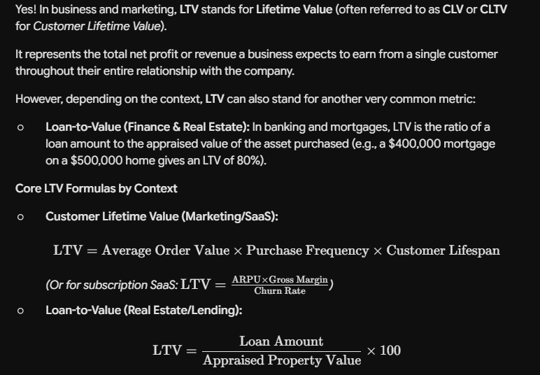
Causal Impact Analysis
2
Goal: How? Conclusions? Business recs?

Slide 18
Project 4

Slide 19
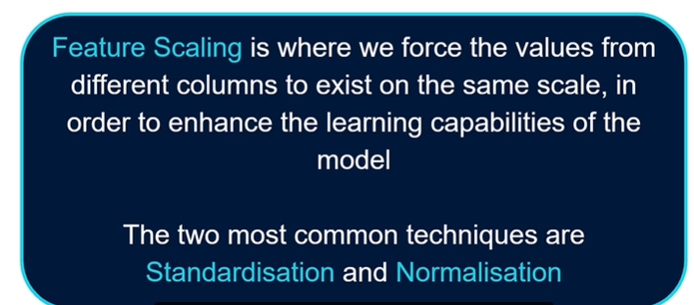
Feature Scaling

Slide 20
Feature Scaling
X_train_encoded = one_hot_encoder.fit_transform(X_train[categorical_vars])
X_test_encoded = one_hot_encoder.transform(X_test[categorical_vars])
FIT with test data, FIT TRANSFORM with train data

Slide 21
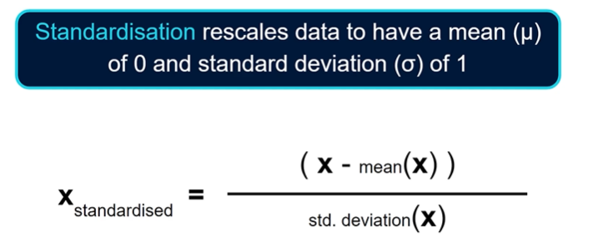
Which py modules?

Slide 22
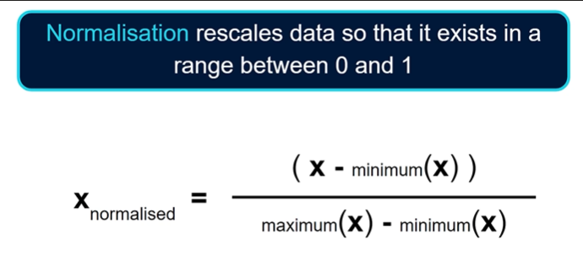
Which py modules?

